Slide 1






Cross platform form generator with schema driven automation
25-26J-436
Mr. Jeewaka Perera Lecturer Faculty of Computing | Computer Science
Ms. Thilini Jayalath Senior Lecturer Faculty of Computing | Software Engineering
Dissanayake D. M. T. V.
(Leader)
IT22003546
Gunawardena T. S.
IT22350114
Rajapakshe P. H. Y. L.
IT22305350
Liyanage M. I. H.
IT22332608
25-26J-436

Slide 2


PROBLEM
System Overview
Manual schema and form creation
Frontend-backend validation duplication
Accessibility handled inconsistently
Manual and error-prone data mapping
Fragmented form development tools
Single intelligent schema as the source of truth
Automated frontend form generation with WCAG 2.1 compliance
Automated backend API and DTO generation
Synchronized validation and data mapping across layers
Comprehensive test case generation
Visual drag-and-drop customization
Cross platform form generator with schema driven automation
25-26J-436

Slide 3
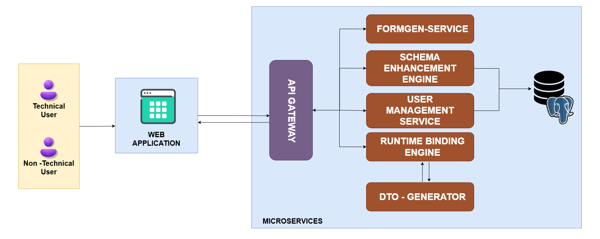
System Architecture
Figure 1: FormSync System Diagram
Cross platform form generator with schema driven automation
25-26J-436

Slide 4
By PP2, the proposed scope was completed, and the received feedback was incorporated into the final system.
Suggestions received during the PP2 | How we addressed them
Add support for a low-level frontend stack such as HTML. | Added HTML + Bootstrap + Vanilla JS frontend generation.
Introduce an additional backend stack to show extensibility. | Added Node.js + Express.js and .NET backend generation.
Extract form-related user stories from an SRS document. | Built an SRS user-story extractor that converts requirements into JSON Schema.
Built and automated deployment using GitHub Actions, deployed on Amazon Web Services (AWS), and managed infrastructure with Terraform and Ansible (IaC)
Contextual Test Case Generation using schema
Submitted the research paper to TENSYMP ’26 and MERCon ’26 conferences
Cross platform form generator with schema driven automation
25-26J-436

Slide 5
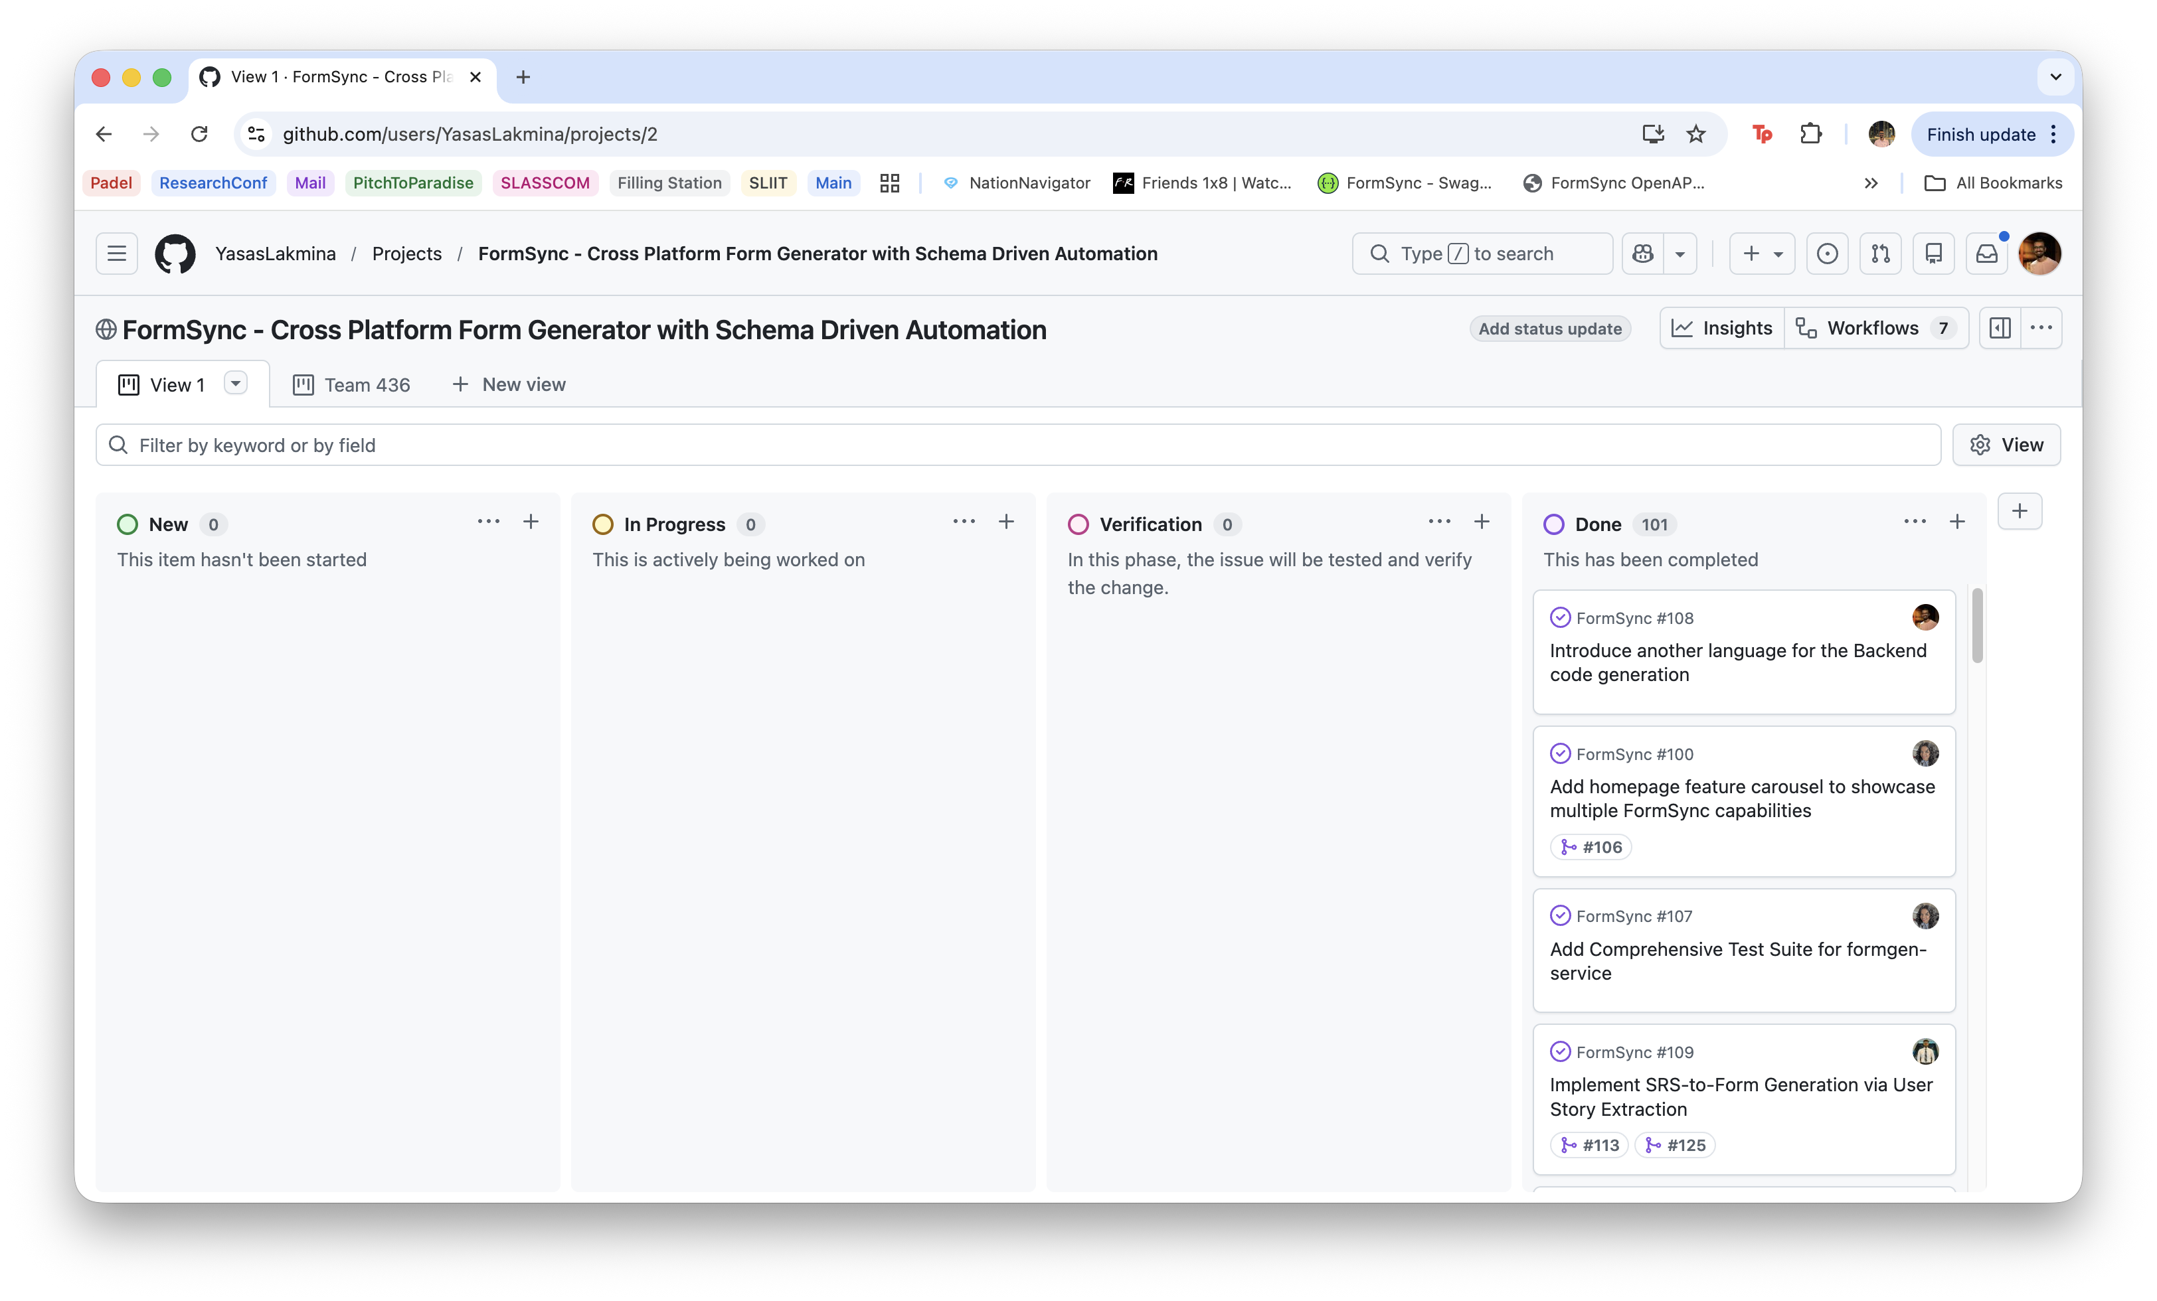
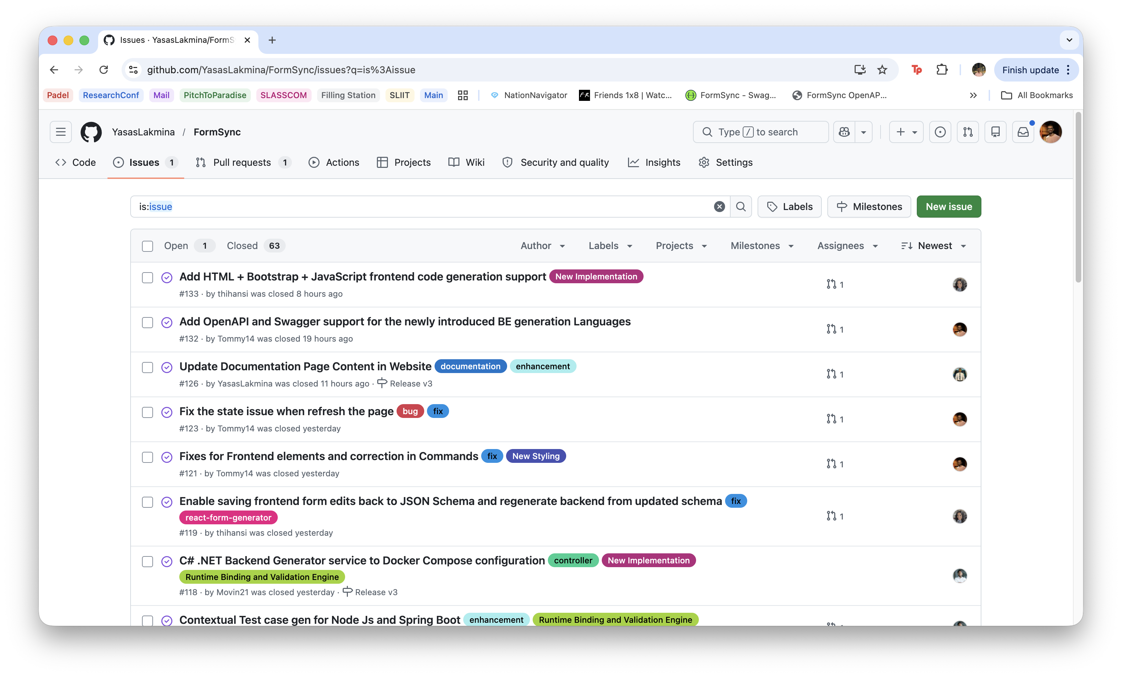
PROJECT MANAGEMENT
Figure 2: GitHub-based project management board used to track tasks, progress, verification, and completed milestones of the FormSync system.
Figure 3: GitHub issue and pull request history used to manage and track development progress.
Cross platform form generator with schema driven automation
25-26J-436

Slide 6
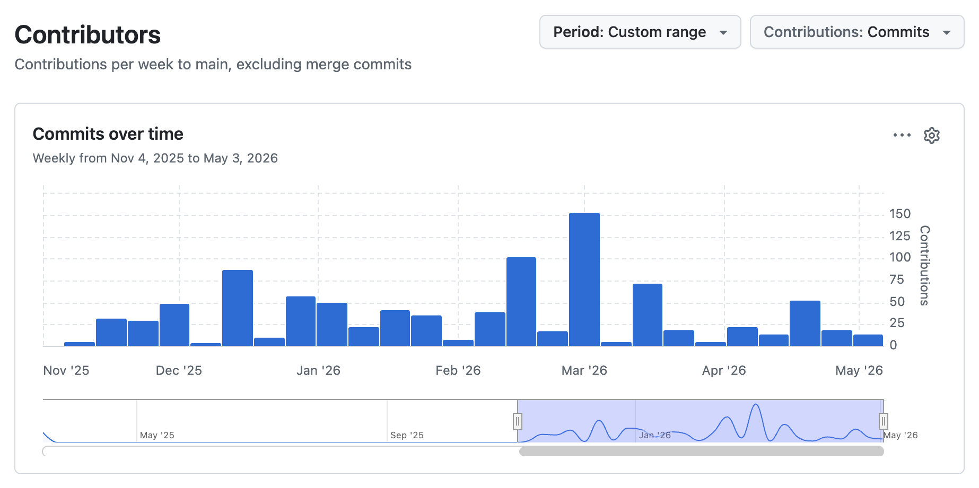
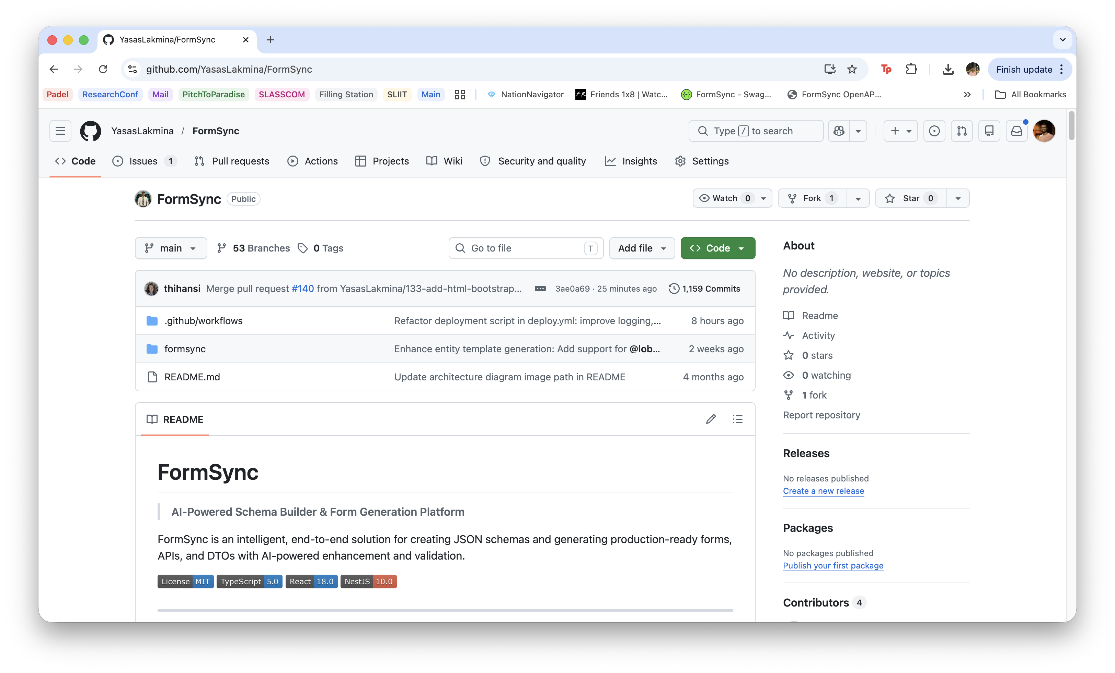
PROJECT MANAGEMENT
Figure 4: Visualization of repository commit frequency showing continuous development and feature implementation throughout the project lifecycle.
Figure 5: GitHub repository hosting the complete FormSync platform, including the schema builder, generated APIs, documentation, and system architecture.
Cross platform form generator with schema driven automation
25-26J-436

Slide 7
Intelligent Schema Definition and AI Integration
IT22305350 | Rajapakshe P H Y L
Multi-format input support (JSON/YAML/XML).
Rule Base schema validation and quick fix.
AI-powered schema enhanced suggestions
Dual interface: Technical Editor (Monaco) and visual Template Builder for non-technical users
Rule base Schema Quality Scoring.
Schema versioning metadata and diff for schema
Automated workflow for Technical Editor
Parses SRS documents in PDF, and plain text formats
Extracts user stories using LLM with structured JSON output and saving as projects.
IT22305350 | Rajapakshe P H Y L | 25-26J-436

Slide 8
Schema-Based Frontend Form Builder
IT22350114 | Gunawardena T S
Generates frontend forms from JSON Schema
Uses JSON Schema as the single source of truth
Supports React code generation
Added HTML + Bootstrap + Vanilla JS generation
Provides live form preview and customization
Keeps validation consistent with backend rules
Supports WCAG-focused accessible form output
Exports generated code as part of the complete downloadable project ZIP
IT22350114 | Gunawardena T S | 25-26J-436

Slide 9
SCHEMA-DRIVEN MULTI-STACK BACKEND GENERATOR
IT22003546 | Dissanayake D M T V
Schema-driven backend generation
Spring Boot layered code generation
Node.js Express backend generation
Downloadable backend ZIP output
Plug-and-play multi-stack architecture
Schema-based validation and API consistency
OpenAPI specification generation
Swagger API documentation and testing
IT22003546 | Dissanayake D M T V | 25-26J-436

Slide 10
Runtime-Binding Engine Builder
IT22332608 | Liyanage M I H
Schema-driven backend generation
Spring Boot Server generation with test cases
.Net C# backend generation
Downloadable backend ZIP output
Plug-and-play multi-stack architecture
Contextual Test Case Generation using schema
Swagger API documentation for .Net
Terraform & Ansible for FormSync Infrastructure
IT22332608 | Liyanage M I H | 25-26J-436

Slide 11
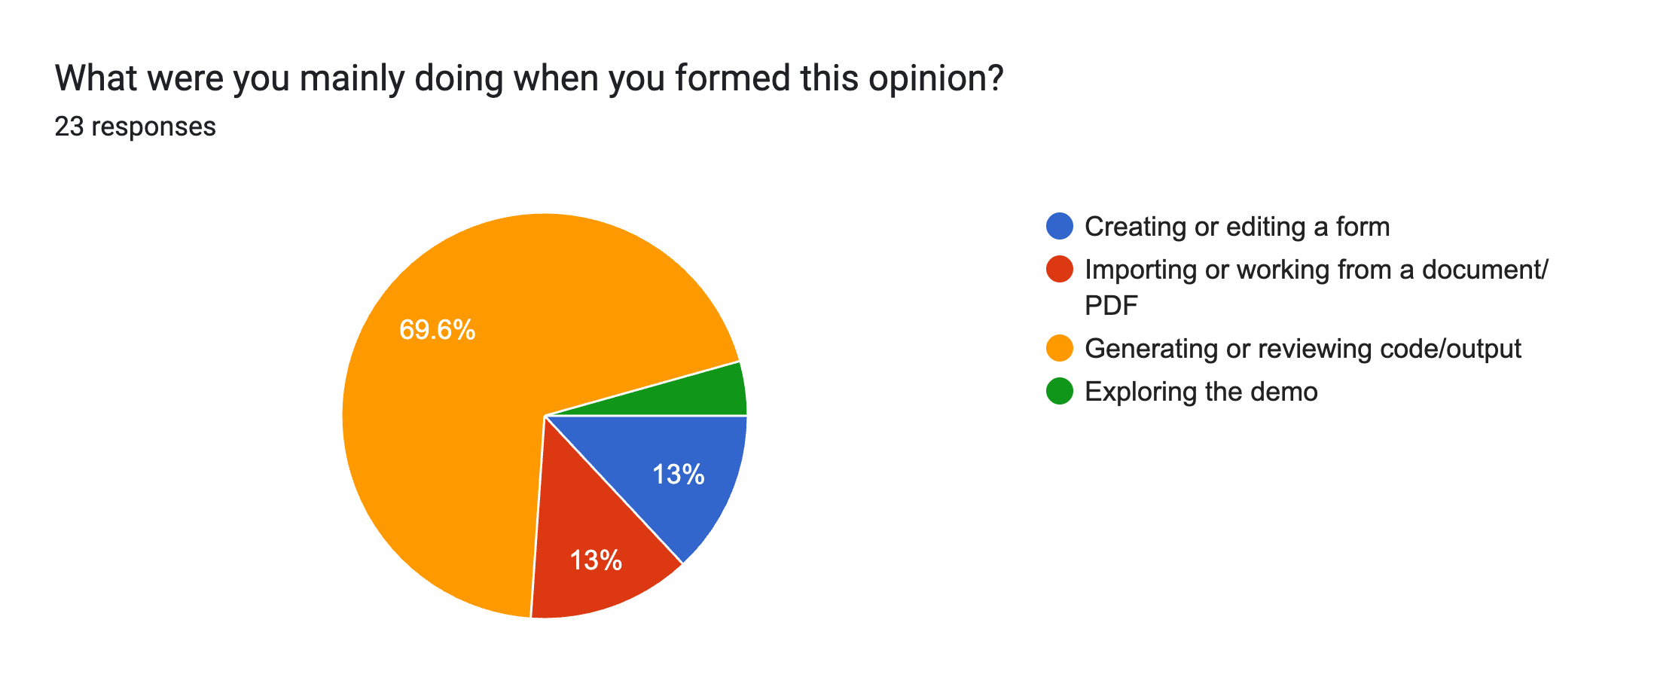
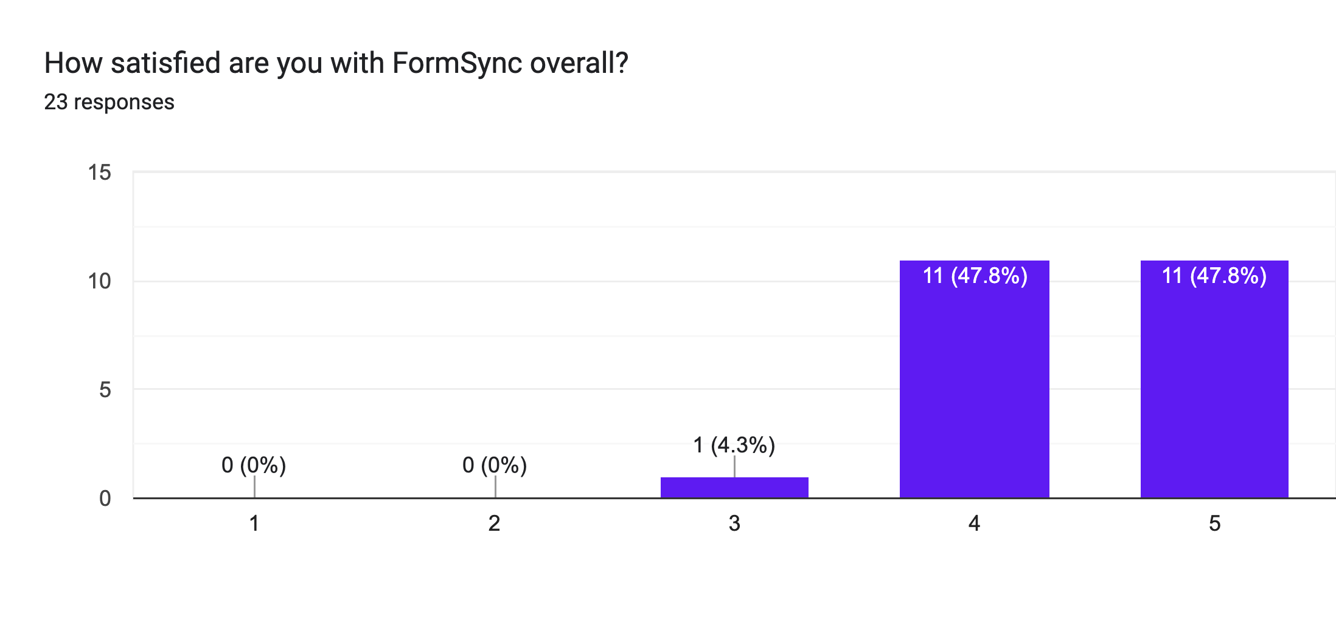
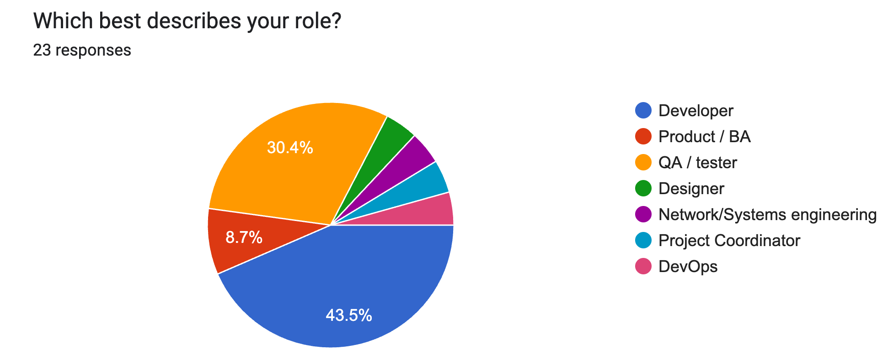
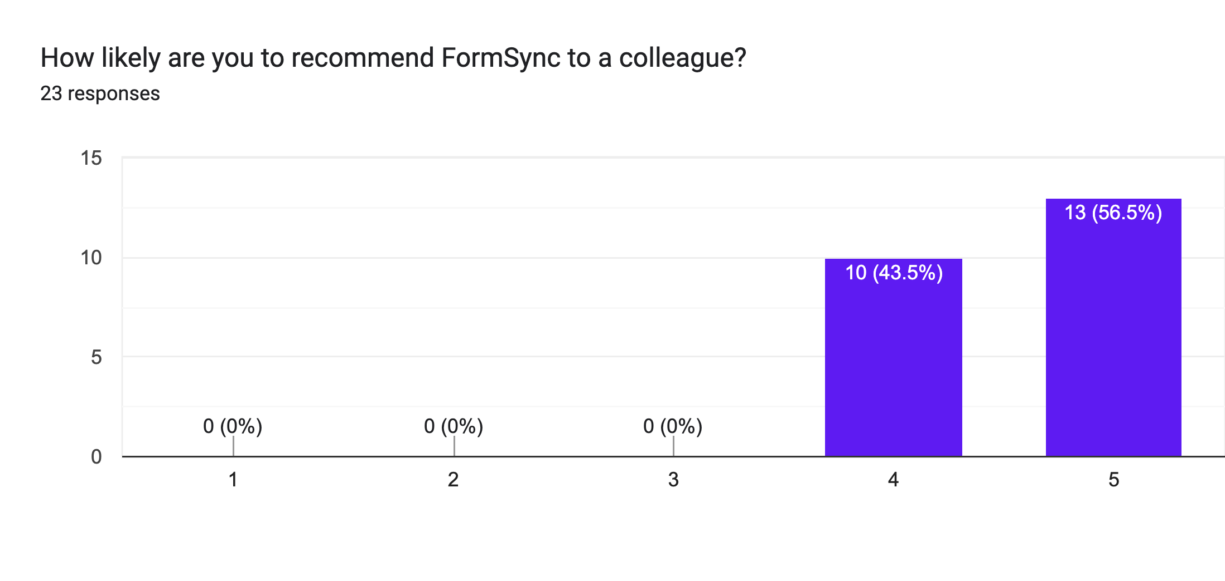
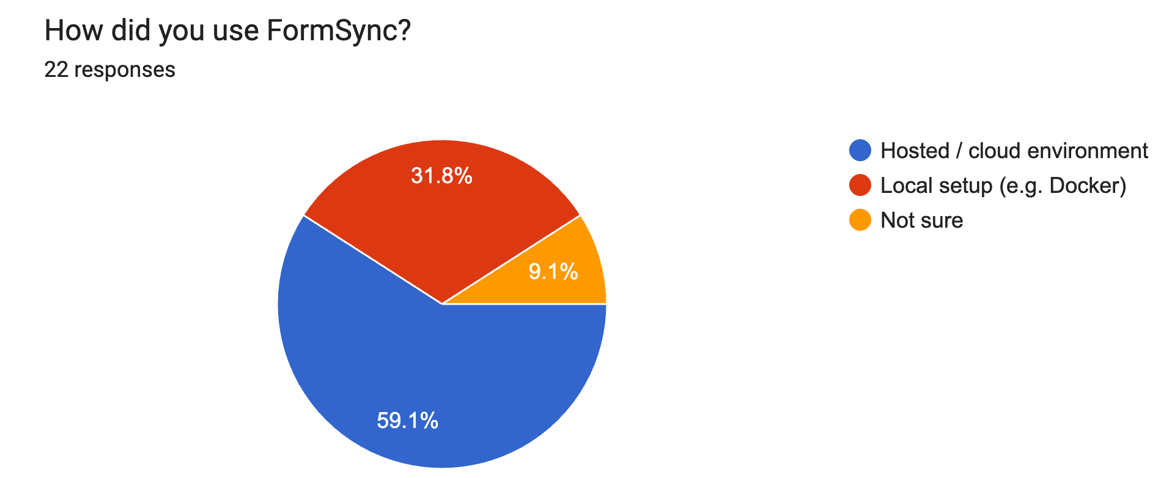
USER FEEDBACK

Slide 12
Demonstration
25-26J-436

